Slide 1


5005CEM Lecture 1a: Module Outline
School of Computing, Mathematics and Data Science Coventry University
5005CEM Data Science 2022/23 Semester 2

Slide 2
Teaching Team (2022/23)
Dr Mark Johnston (module leader)
email: ad4039@coventry.ac.uk

Slide 3

Module Outline
Lectures
Data Science concepts and applications
Mathematics and probability background
Challenges of Big Data
Lab sessions
Data Science methods and processes
R/RStudio/tidyverse software
Exploratory data analysis, applied statistics

Slide 4
Lecture Outline
Weeks 1+2 – Data science and the data science lifecycle
Weeks 3+4 – Exploratory data analysis
Weeks 5+6 – Probability, conditional probability, probability distributions
Weeks 7+8 – Big data
Weeks 9+10 – Matrices, vectors, matrix transformations, application to multivariate data analysis
Week 11 – Review and test preparation
Week 12 – Test (online)

Slide 5
Lab Outline
Weeks 1+2 – Introduction to R/RStudio/tidyverse and tidy data
Weeks 3+4 – Data wrangling (dplyr) and exploratory data analysis (summary statistics, graphical plots, ggplot)
Weeks 5+6 – Statistical models (regression)
Weeks 7+8 – Probability, simulation, statistical significance
Weeks 9+10 – Matrices, vectors, matrix transformations, application to multivariate data analysis
Week 11 – Review and test preparation
Week 12 – Test (online)

Slide 6
Intended learning outcomes
Understand and apply the components of the data science project lifecycle to real-world data science applications.
Select, apply and evaluate a range of appropriate data science methods and software tools to analyse datasets using data wrangling, exploratory data analysis, data visualisation, and predictive analytics.
Demonstrate knowledge and understanding of fundamental concepts in mathematics, probability and data analysis, relevant for data science.
Demonstrate a critical understanding of the drivers, challenges and debates of Big Data, and relevant social, ethical and legal issues.

Slide 7
Assessment
Module is 20 learning credits and 10 assessment credits
Only assessment is a Phase Test in Week 12
Monday 3rd April 2023
Covers all ILOs
Will include analysis of given datasets using R/RStudio
Likely to be 2 hours, open book, not multichoice

Slide 8
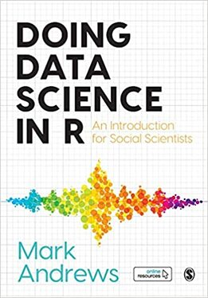
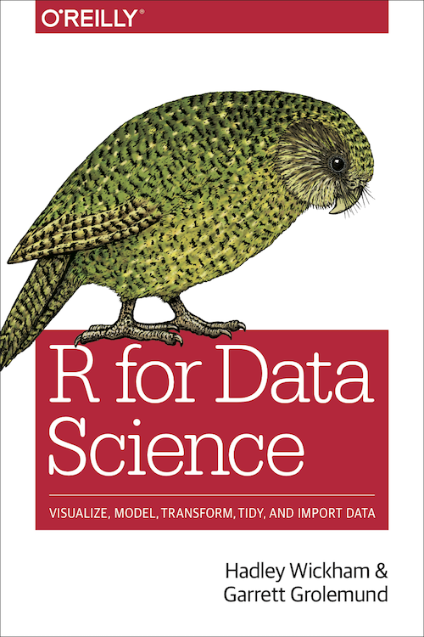
Recommended reading
Andrews, Doing Data Science in R, 2021 [free preprints at https://www.mjandrews.org/book/ddsr/]
Wickham and Grolemund, R for Data Science, 2017 [free at https://r4ds.had.co.nz/]

Slide 9
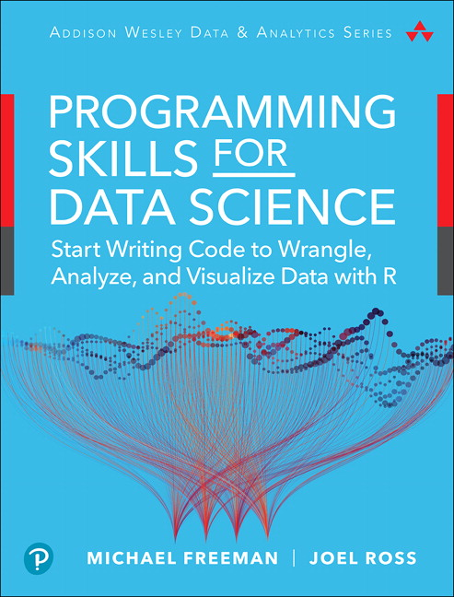
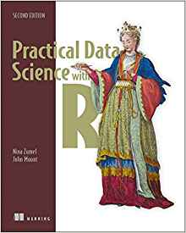
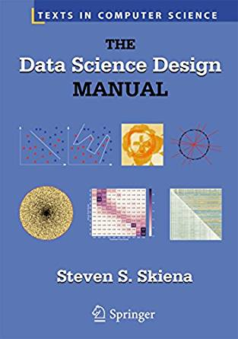
Recommended reading
Freeman and Ross, Programming Skills for Data Science, 2018 [similar to https://info201.github.io/]
Other suggestions on Aula
Notes:
Zumel and Mount: https://www.manning.com/books/practical-data-science-with-r
Skiena: https://www3.cs.stonybrook.edu/~skiena/

